Slide 1

MACHINE LEARNING PROJECT
MOBILE PRICE RANGE CLASSIFICATION
Submitted to:
Ankit Sir

Slide 2

Problem Statement
Core Objective
The objective of this project is to classify the price range of mobile phones based on their technical specifications such as RAM, battery power, screen resolution,
We did multiclass classification where mobile phones are categorized into four price ranges (0, 1, 2, and 3) as per the problem statement. The project focuses on analyzing the data, performing feature engineering, and comparing the performance of five machine learning models to identify the most accurate and reliable model.
Models
SGD Linear Classifier
Logistic Regression
Decision Tree
Random Forest
K-Nearest Neighbours

Slide 3
Workflow
Data collection
Preprocessing
a. DATA CHECKING
b. DATA CLEANING
c. VERIFY FEATURE UNIT
d. UNIT CONVERSION
e. EDA
f. FEATURE ENGINEERING
g. ENCODING TARGET
h. TRAIN/TEST SPLIT
SCALING
Train model
Hyperparameter tuning
Evaluate and compare
CROSS VALIDATION
FINALE TEST EVALUATION
Confusion matrix of all 5 model with classification report
Visual representation of confusion matrix
Classification report for best model
Test accuracy
FEATURE IMPORTANCE
SCATTER PLOT FOR EVERY MODEl

Slide 4
Step 1: data collection
Data Collection & Description
SOURCE OF DATA:
GitHub
DATASET SIZE:
ROWS: 2000
COLUMNS: 21
COLUMN NAME:
Battery_power
blue
clock_speed
dual_sim
fc
four_g
int_memory
m_dep
mobile_wt
n_cores
pc
px_height
px_width
ram
sc_h
sc_w
talk_time
three_g
touch_screen
Wifi
price_range (target)

Slide 5
STEP 2: DATA PREPROCESSING
Data Checking
Purpose of Data Checking: The main purpose of checking missing values and duplicate rows is to ensure that the dataset is clean, consistent, and unbiased before applying preprocessing and model training.
Checking for Missing Values: Missing values can confuse machine learning algorithms and lead to incorrect pattern learning, resulting in poor model accuracy. Therefore, the dataset is examined to detect any null or empty entries.
Checking for Duplicate Row: Duplicate records can bias the model by repeating the same information multiple times. This may cause overfitting and produce misleading performance results.

Slide 6
Data Cleaning
STEP 2: DATA PREPROCESSING
Data cleaning is the process correcting or removing errors, missing values, duplicates, and inconsistencies in a dataset to improve data quality.
It ensures that the data is accurate, consistent, and suitable for analysis and machine learning models.

Slide 7
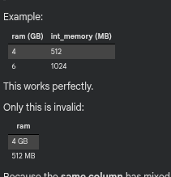
Verify Feature Unit
STEP 2: DATA PREPROCESSING
Feature unit verification is the process of ensuring that all values within a single feature column are measured using the same unit. While different columns may have different units, a single column must not contain mixed units, as this can confuse the machine learning model and lead to incorrect learning.
In this project, all numerical feature columns were carefully analysed by examining their value ranges to confirm unit consistency. Features such as RAM, internal memory, battery power, screen resolution, mobile weight, screen dimensions, depth, and clock speed were checked individually.
ram, int_memory,battery_power,
px_height,px_width,mobile_wt,
sc_h,sc_w,m_dep,clock_speed,

Slide 8
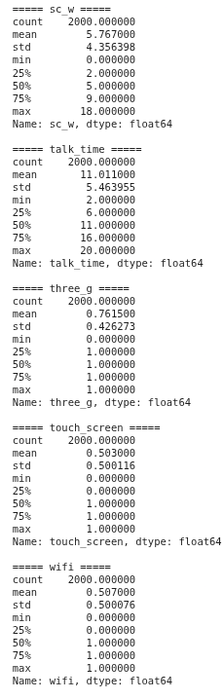
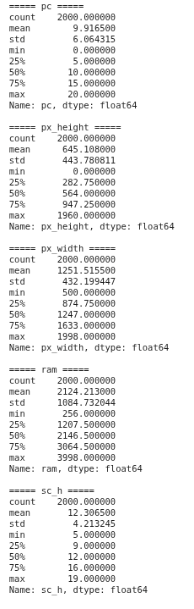
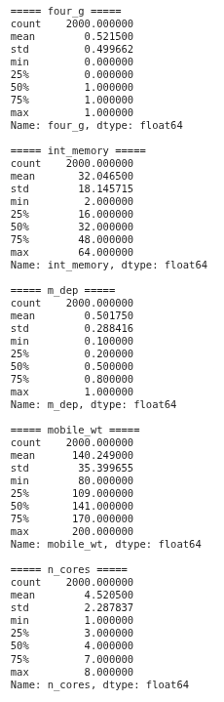
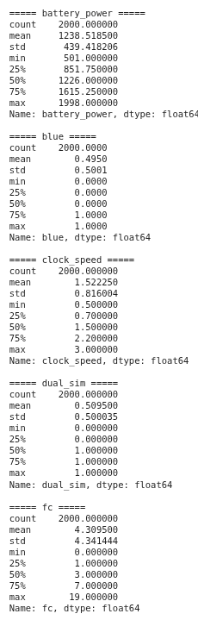
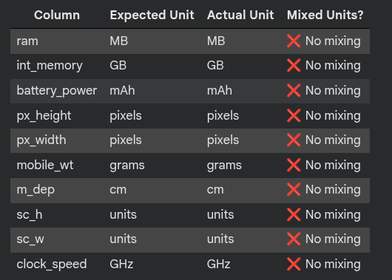

Slide 9
Unit Conversation
STEP 2: DATA PREPROCESSING
Convert RAM and storage values from megabytes (MB) to gigabytes (GB) to maintain unit consistency. This conversion is essential for accurate feature analysis and modeling. Overwrite the original columns after conversion to ensure uniform scales across the dataset, preventing errors during data processing stages.
A) Overwrite original RAM column
df['ram'] = df['ram'] / 1024
Result:
ram becomes GB
No extra column created
✔ Clean ✔ Simple ✔ No confusion ✔ Best for modeling
B) Create new column
df['ram_gb'] = df['ram'] / 1024
Result:
ram = still MB
ram_gb = new column in GB

Slide 10
STEP 2: DATA PREPROCESSING
Exploratory Data Analysis
EDA (Exploratory Data Analysis) is the process of analysing and visualizing data to understand its structure, patterns, and problems before applying machine-learning models.
Dataset Info: The dataset information is checked to understand the number of rows, columns, data types, and overall structure of the data.
Statistical Summary: Descriptive statistics such as mean, minimum, maximum, and standard deviation are examined to understand the data distribution and value ranges.
Target Distribution (Price Range): The distribution of the target variable (price range) is analyzed to check class balance among low, mid, and high-priced mobiles.
Correlation Heatmap: A correlation heatmap is used to identify relationships between features and detect highly correlated variables that influence the price range.
Outlier summary: An outlier summary shows the number of outliers detected in each feature of the dataset.Outliers are data points that lie far away from the normal range of values and can affect model performance.
Feature distribution box plot: A feature distribution box plot is a statistical visualization used to show how the values of a feature are distributed across different categories of the target variable.
Feature Distribution Plot (Histogram with KDE): Important features such as battery power, RAM, pixel height, pixel width, and internal memory are compared with price range to understand their impact on mobile pricing.
Scatterplot: A scatter plot is a graphical representation used to show the relationship between two numerical features by plotting data points on a two-dimensional plane. Each point in the plot represents a single data sample, where:
The x-axis represents one feature
The y-axis represents another feature

Slide 11
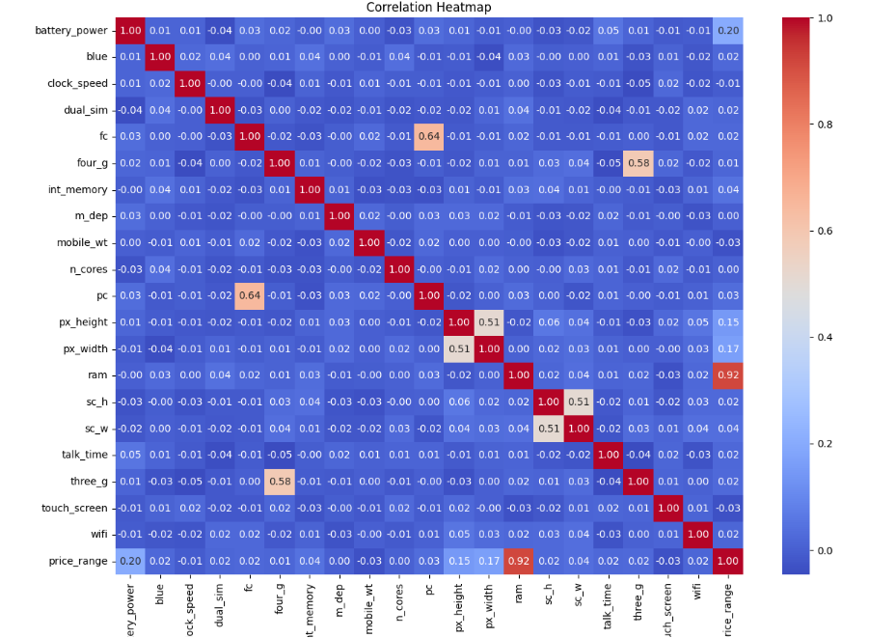
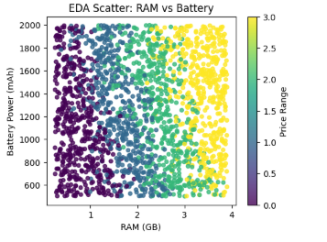
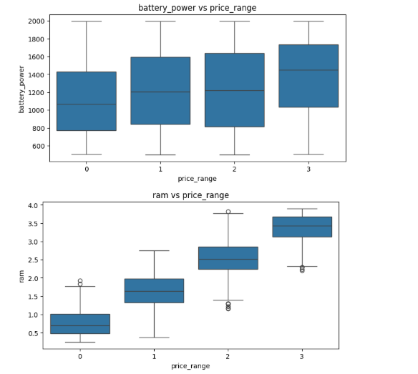
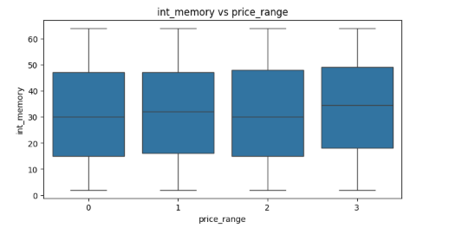
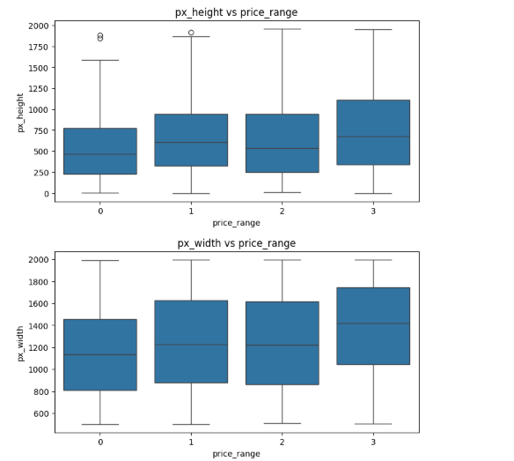
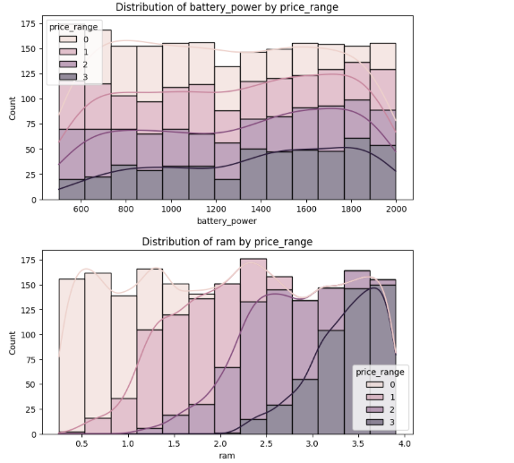
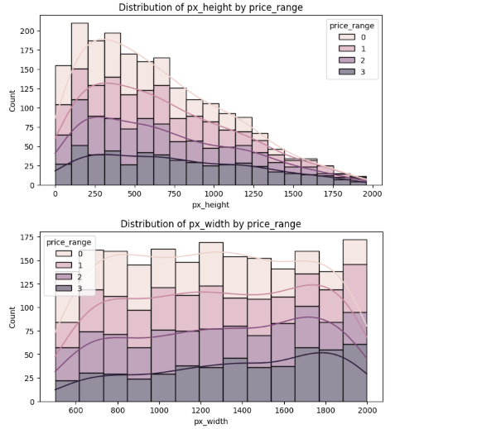
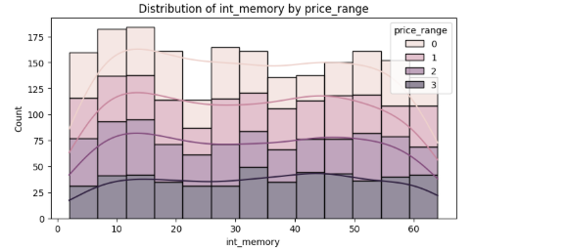
STEP 2: DATA PREPROCESSING

Slide 12
STEP 2: DATA PREPROCESSING
Feature Engineering
Feature engineering is the process of creating new meaningful features or transforming existing features to improve the performance of a machine learning model.
It helps the model better understand patterns in the data by reducing overlap, capturing relationships, and making features more informative.
Added features:
['resolution'
, 'ppi'
, 'battery_efficiency'
, 'ram_int_ratio'
, 'ram_battery_combo'
, 'res_area'
, 'ram_level'
, 'log_battery_power'
, 'log_ram'
, 'log_resolution']
Example :
Resolution =px_height*px_width
Correlation heatmap score of px_height*px_width = 0.51
Range 0-1

Slide 13
STEP 2: DATA PREPROCESSING
Encoding Target
Target encoding is the process of converting the target variable (class labels) into a numerical format that machine learning models can understand.
In classification problems, categorical target values are mapped to numeric labels.
Eg:- raw data very low, low, high, very high,
Encoding:- very low-0, low-1, high-2, very high-3

Slide 14
STEP 2: DATA PREPROCESSING
Data Splitting(Train-Test 80-20)
The dataset is divided into two parts:
80% Training data – used to train the model
20% Testing data – used to evaluate model performance on unseen data
This helps in checking how well the model generalizes to new data and prevents overfitting.
Our Split data :- Train shape : (1600, 30) Test shape : (400, 30)

Slide 15
STEP 2: DATA PREPROCESSING
Standardization
Standardization is a data preprocessing technique used to scale numerical features so that they have:
Mean = 0
Standard deviation = 1
This ensures all features are on the same scale.
Why standardization is used:
Prevents features with large values from dominating
Example: Standardization of RAM
Assume RAM values (GB) in training data:
[2, 4, 6, 8]
Step 1: Calculate Mean (μ)=( 2+4+6+8)/4 = 20/4=5
Step 2: Calculate Standard Deviation (σ)
=root[(2-5)^2+(4-5)^2+(6-5)^2+(8-5)^2]/4 = root5= 2.236
Step 3: Standardize one value (x = 8 GB)
= z=(x-u)/sigma
Z=(8-5)/2.236=3/2.236=1.34
Original ram= 8 standardized ram +1.34
2 → −1.34
4 → −0.45
6 → +0.45
8 → +1.34
Now check the standardized feature
Mean of all z-values ≈ 0
Standard deviation of all z-values ≈ 1
This is where mean = 0 and std = 1 happen

Slide 16
STEP 3: MODEL TRAIN
Training all 5 Models
SGD linear Classifier
1️⃣ SGD Linear Classifier
What it is: A linear classification model trained using Stochastic Gradient Descent.
How it works (steps):
Initializes weights
Calculates prediction error
Updates weights using gradient descent
Repeats until loss is minimized
Core idea / formula:
y =mx+c
Key point:
Fast and efficient for large data
Works well when data is linearly separable
Logistic Regression
2️⃣ Logistic Regression
What it is: A probability-based linear classifier used for multiclass classification.
How it works (steps):
Computes weighted sum of features
Applies sigmoid /
Assigns class with highest probability
Core idea / formula:
y =1/1+e^(-mx+c)
Key point:
Stable and interpretable
Best-performing model in this project
Decision Tree
3️⃣ Decision Tree
What it is: A rule-based model that makes decisions using if–else conditions.
How it works (steps):
Selects best feature to split data
Creates branches based on conditions
Continues splitting until stopping criteria
Core idea:
Uses Gini Impurity / Entropy to select splits
Gini=1−∑p^2
Key point:
Easy to understand
Can overfit if not controlled
Random Forest
4️⃣ Random Forest
What it is: An ensemble model made of multiple decision trees.
How it works (steps):
Trains many decision trees on random subsets
Each tree makes a prediction
Final output is based on majority voting
Core idea:
Final Prediction=Mode of all tree predictions
Key point:
Reduces overfitting
More stable than a single decision tree
KNN
5️⃣ K-Nearest Neighbours (KNN)
What it is: A distance-based model that predicts based on nearby data points.
How it works (steps):
Calculates distance to all training points
Selects K nearest neighbors
Predicts the most common class
Core idea / formula:
D= root((x1-x2)^2+(y1-y2)^2)
Key point:
Simple and intuitive
Sensitive to noise and scaling

Slide 17
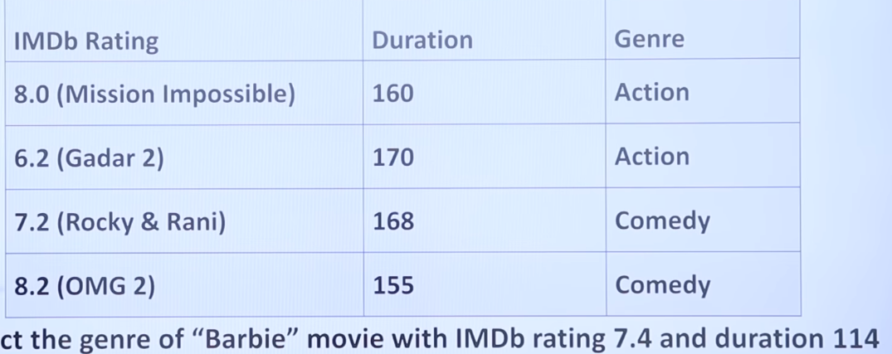
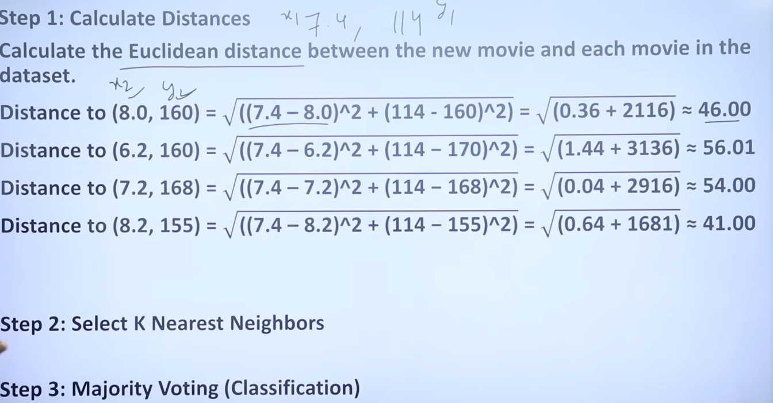
STEP 3: MODEL TRAIN
KNN
KNN
5️⃣(KNN)
What it is: A distance-based model that predicts based on nearby data points.
How it works (steps):
Calculates distance to all training points
Selects KNN
Predicts the most common class
Core idea / formula:
D= root((x1-x2)^2+(y1-y2)^2)
Key point:
Simple and intuitive
Sensitive to noise and scaling

Slide 18
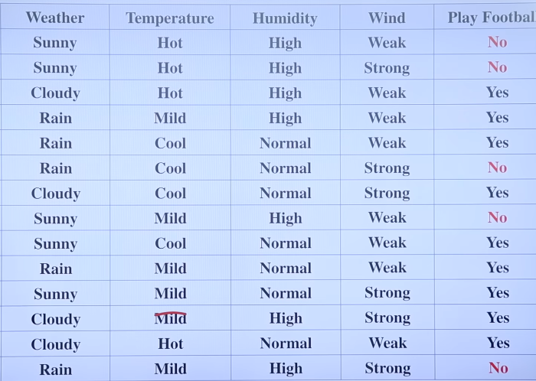
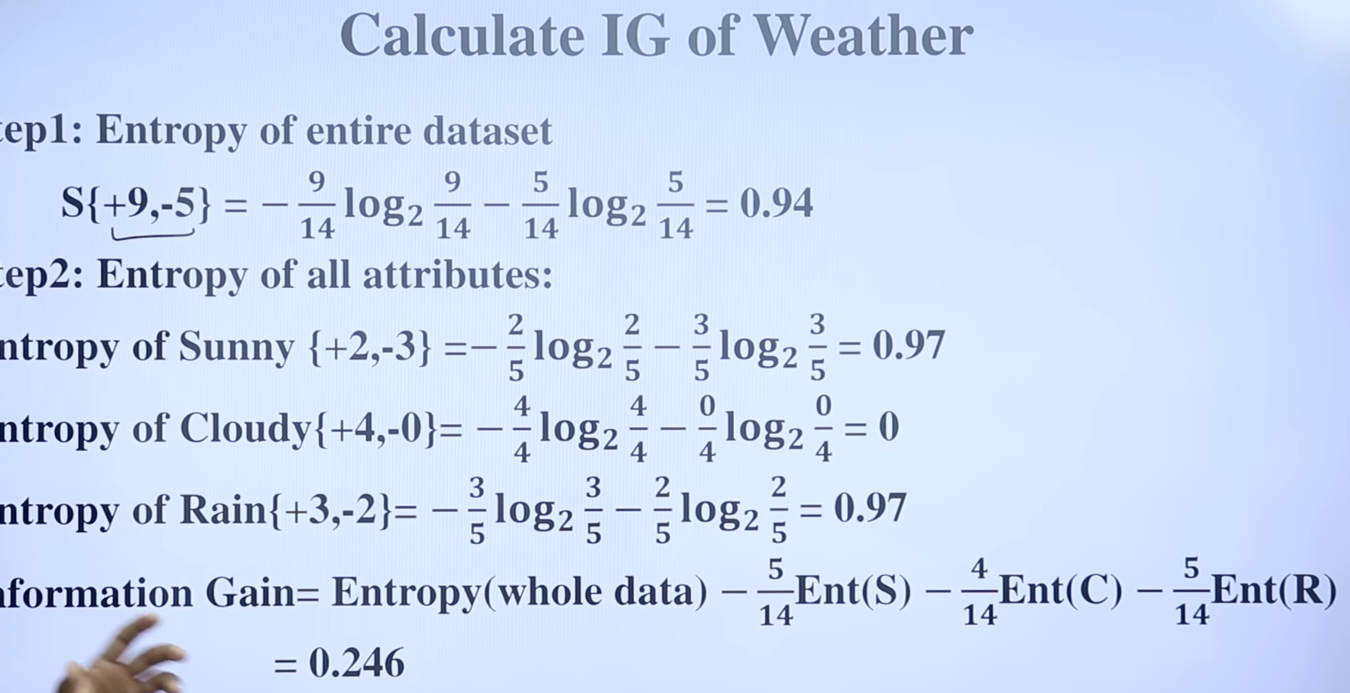
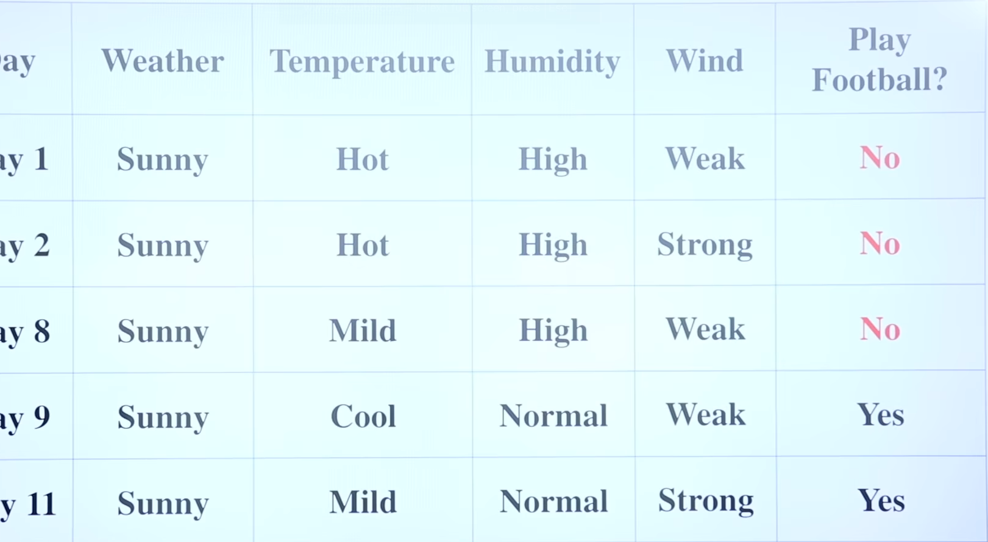
STEP 3: MODEL TRAIN
DECISION TREE
Decision Tree
3️⃣ Decision Tree
What it is: A rule-based model that makes decisions using if–else conditions.
How it works (steps):
Two main method (Gini impurity) and (entropy +information gain)
What we use:
Entropy
First choose whom to make root node
a. first for root node you have to calculate entropy and IG of 1.
Entropy whole dataset 2. Entropy of all-weather sunny cloudy rain 3. IG
b. do same with temp , humidity, wind 1. entropy of whole data set 2. entropy of all attributes 3rd IG
c. choose the max IG which will be our root node(weather) 0.246
2. weather as root node in these we have sunny, cloudy, rain.
Cloudy yes always yes so we have sunny and rain
3. now calculate from the point of sunny
Pick all the sunny rows from the dataset (5 rows) to find next vertex
Now inside sunny we have temp, humidity, wind to choose whom to make vertex
Now according to this dataset of sunny find IG, 1. entropy of sunny, 2. entropy of attribute of sunny hot mild cool 3. IG
Now do same with temp, humidity, wind, 1. entropy of sunny 2. entropy of attributes of temp/humidity/wind 3. IG 4. pick the max IG for next vertex(humidity 0.57) after humidity we will have high or normal if high NO, if normal YES we reach leaf node, do same with rain

Slide 19
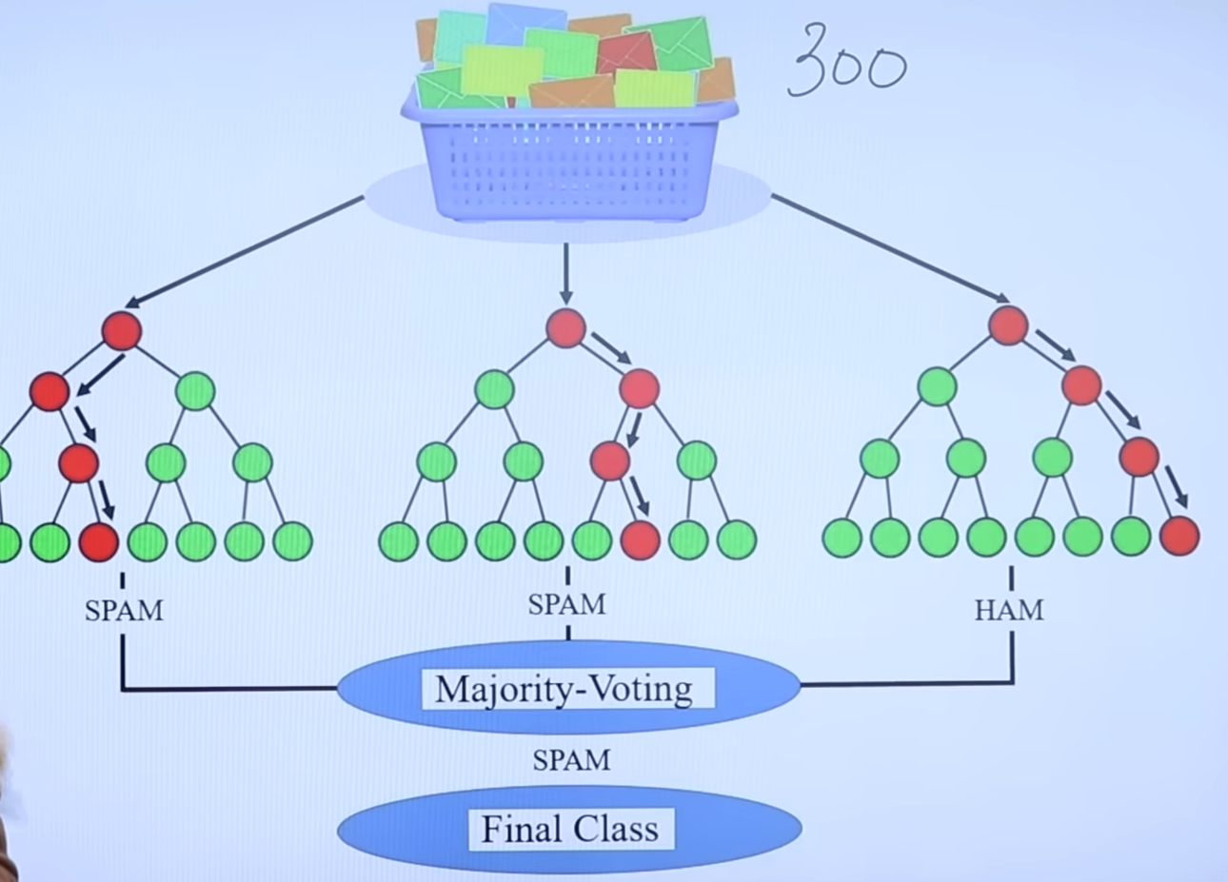
STEP 3: MODEL TRAIN
Random Forest
Random Forest
4️⃣ Random Forest
What it is: Random forest is an ensemble learning method for classification, regression.(accurate is classification)
Random forest correct for decision tress habit of overfitting their training set.
Key point:
Reduces overfitting
More stable than a single decision tree

Slide 20
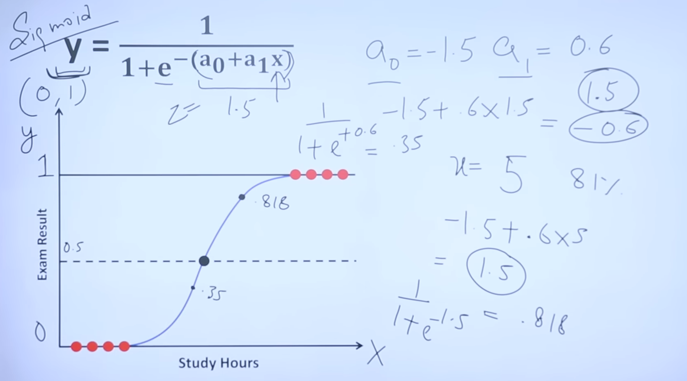
STEP 3: MODEL TRAIN
Logistic Regression
Logistic Regression
2️⃣ Logistic Regression
What it is: A probability-based linear classifier used for multiclass classification.
How it works (steps):
Core idea / formula:
y =1/1+e^-(Ao+A1x) sigmoid function y= range 0-1
Ao= intercept, A1= if I change A1 then how much change it cause in y
X=independent variable
How to find value of Ao and A1:
It work on maximum likelihood estimation then in that we optimize cost function again and again with gradient decent method
Key point:
Stable and interpretable
Best-performing model in this project

Slide 21
STEP 3: MODEL TRAIN
SGD Linear Classifier
SGD linear Classifier
1️⃣ SGD Linear Classifier
What it is: A linear classification model trained using Stochastic Gradient Descent.
How it works (steps):
Initializes weights
Calculates prediction error
Updates weights using gradient descent
Repeats until loss is minimized
Key point:
Fast and efficient for large data
Works well when data is linearly separable

Slide 22
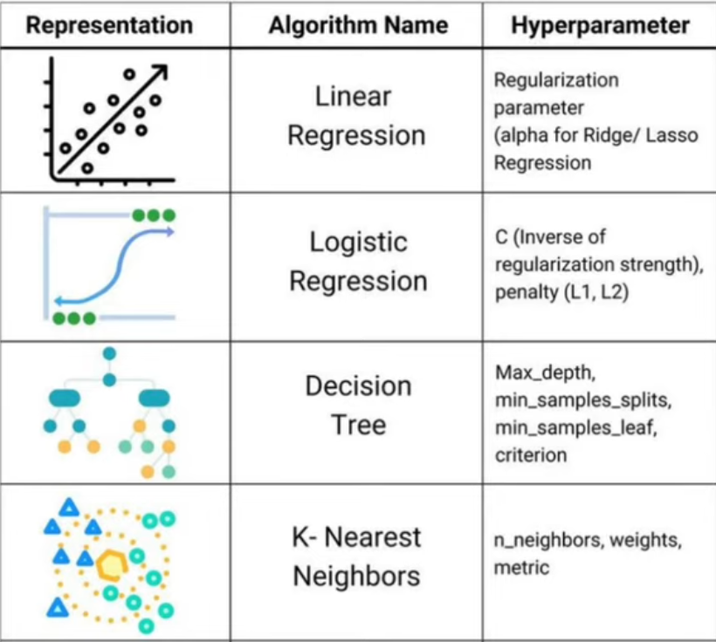
STEP 4: HYPERPARAMETE TUNING
Hyperparameter tuning
Hyperparameter tuning is the process of adjusting the machine learning model’s settings in order to improve its performance. These settings are not learned from the data but are defined before training the model.
In this process, multiple combinations of hyperparameters are tested to find the configuration that gives the best accuracy and overall performance. Techniques such as GridSearchCV and RandomizedSearchCV are commonly used to systematically search for the best hyperparameter values.
By selecting optimal hyperparameters, hyperparameter tuning helps in improving model accuracy and also in avoiding overfitting and underfitting.

Slide 23
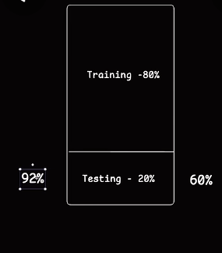
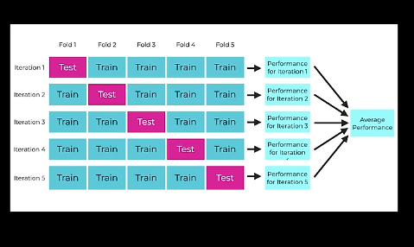
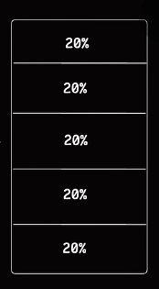
STEP 5: Evaluate and compare
Cross Validation Comparison
Cross-validation comparison is a method used to fairly compare the performance of multiple machine learning models by evaluating them on the same data splits.
In this project:
5-fold cross-validation was used
The dataset was divided into 5 equal folds
Each model was trained on 4 folds and tested on 1 fold
This process was repeated 5 times
The average performance score (accuracy) of each model was calculated and compared to select the best performing model.

Slide 24
STEP 5: Evaluate and compare
Finale Test Evaluation
Final Test Evaluation
Final test evaluation is performed on the test dataset, which the model has never seen before. It measures the true performance of the best tuned model on unseen data.
Evaluation Metrics Used
1. Confusion Matrix with Classification Report
4×4 matrix for price ranges (0–3)
Rows: actual class
Columns: predicted class
Diagonal → correct predictions
Off-diagonal → misclassifications
Helps analyze class-wise errors
2. Visual Confusion Matrix
Graphical representation of predictions
Shows correct vs incorrect classifications
Helps understand error patterns visually
3. Classification Report
Precision – prediction correctness
Recall – ability to find all samples
F1-score – balance of precision & recall
Macro & weighted averages included
4. Test Accuracy
Measures overall correctness on unseen data
Indicates model generalization

Slide 25
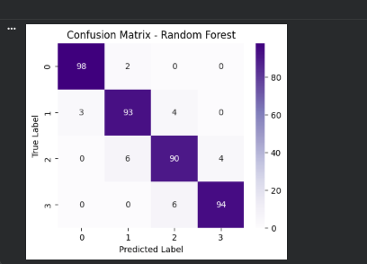
STEP 5: Evaluate and compare
Confusion Matrix with Classification report
Confusion matrices and classification reports were used to evaluate all five tuned models. The confusion matrix shows correct and incorrect predictions for each price range class (0–3), helping identify misclassification patterns. The classification report provides precision, recall, F1-score, and overall averages, allowing a fair comparison of model performance beyond accuracy.

Slide 26
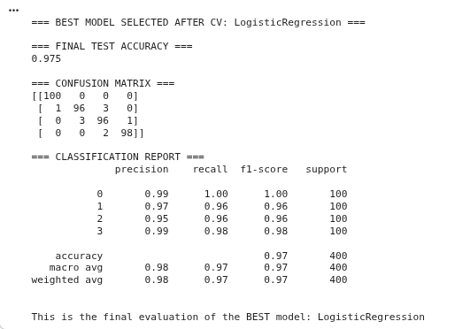
STEP 5: Evaluate and compare
Classification Report
A classification report is a summary table that shows how well a classification model performs for each class using metrics like precision, recall, F1-score, and support.
What it tells us:
Precision → Out of predicted class, how many were correct
Recall → Out of actual class, how many were correctly found
F1-score → Balance between precision and recall
Support → Number of actual samples in each class

Slide 27
STEP 5: Evaluate and compare
Classification Report
1️⃣ True Positive (TP)
👉 Model said YES and actual answer was YES
2️⃣ True Negative (TN)
👉 Model said NO and actual answer was NO
3️⃣ False Positive (FP)
👉 Model said YES but actual answer was NO
4️⃣ False Negative (FN)
👉 Model said NO but actual answer was YES
Accuracy = (TP + TN) / Total samples= correct prediction/ total test data
Precision = TP / (TP + FP)= correct yes/total yes
Recall = TP / (TP + FN)
F1 Score = 2 × (Precision × Recall) / (Precision + Recall)
Support = Number of samples per class

Slide 28
STEP 5: Evaluate and compare
Test Accuracy
Test accuracy is the percentage of correct predictions made by the model on the test dataset, which contains data the model has never seen during training.
Formula
Test Accuracy= Correct Predictions/Total Test Sample
Example
Test samples = 400
Correct predictions = 380
Test Accuracy = 380/400 = 95%

Slide 29
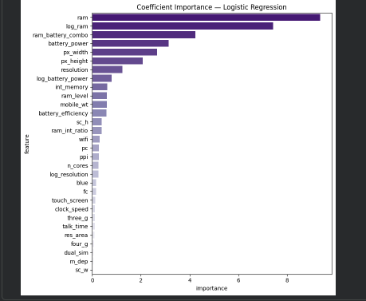
STEP 5: Evaluate and compare
Feature Importance
Feature importance shows how much each input feature contributes to the model’s predictions. It helps identify which features have the greatest influence on the target variable and which features have little or no impact.

Slide 30
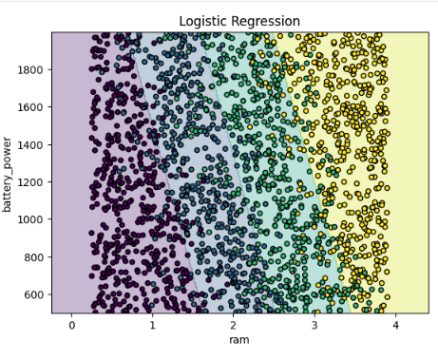
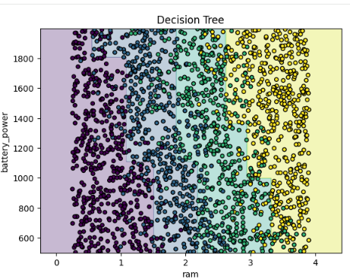
STEP 5: Evaluate and compare
Scatter Plot
A scatter plot is a visual graph used to show the relationship between two numerical features by plotting individual data points on a 2-D plane.
In this project:
X-axis → RAM
Y-axis → Battery Power
Color → Price Range
Scatter plots help in:
Understanding patterns and trends
Identifying overlap between classes
Visualizing model decision boundaries

Slide 31
STEP 5: Evaluate and compare
Conclusion
1. SGD Classifier -linear
Test Accuracy: 92.75% Error %: 7.25%
Advantages:-
· Simple and fast to train
· Works well with standardized features
· Interpretable coefficients
· Good baseline model
Disadvantages:-
· Assumes linear decision boundaries
· Slightly lower performance on overlapping classes (1 & 2)
· Less flexible than non-linear models
Observation:-
· Performs well but misclassifies mid-range price classes slightly more.
2. Logistic Regression
Test Accuracy: 97.5% (Highest) Error %: 2.5% (Lowest)
Advantages:-
· Best overall accuracy, precision, recall, and F1-score
· Stable and consistent across all classes
· Handles multi-class classification very well
· Highly interpretable coefficients
· Low overfitting risk
Disadvantages:-
· Assumes linear separability in feature space
· Cannot capture very complex non-linear relations (without kernels)
Observation:-
· Almost perfect confusion matrix
· Balanced performance across all price ranges
3. Decision Tree
Test Accuracy: 88.5% Error %: 11.5%
Advantages:-
· Easy to visualize and interpret
· Captures non-linear relationships
· No need for feature scaling
Disadvantages:-
· Prone to overfitting
· Sensitive to small data changes
· Lower generalization accuracy
Observation:-
· Struggles with class 1 and class 2 separation
4. Random Forest
Test Accuracy: 93.75% Error %: 6.25%
Advantages:-
· Handles non-linear patterns well
· Less overfitting than decision tree
· Good feature importance insights
· Robust and stable
Disadvantages:-
· More computationally expensive
· Less interpretable than Logistic / Linear
· Slightly lower accuracy than Logistic Regression
Observation:-
· Very strong performer, but still behind Logistic Regression
5. K-Nearest Neighbors (KNN)
Test Accuracy: 82.5% Error %: 17.5% (Highest)
Advantages:-
· Simple concept
· No training phase
· Captures local patterns
Disadvantages:-
· Sensitive to feature scaling and noise
· High prediction time
· Performs poorly in high-dimensional data
· Lowest accuracy among all models
Observation:-
· Confusion between mid-range classes is high

Slide 32
STEP 5: Evaluate and compare
Best Model
Logistic Regression
Justification:
Logistic Regression was selected as the best model because:
1. It achieved the highest test accuracy (97.5%)
2. It had the lowest error percentage (2.5%)
3. It showed consistent performance across all classes
4. Precision, recall, and F1-score were uniformly high
5. The confusion matrix showed minimal misclassification
6. The model generalized well during cross-validation
7. It is computationally efficient and easy to interpret

Slide 33





Flow Chart Of Team Coordination
Chandan Rajput
Data Collection
Dataset
Yash Pratap Singh Thakur
Coder / ML Model Implementation
Code Output
Review PPT
Evaluation and Model Comparison Data
Palak Machhiwal
Report Writing & Documentation
Code and Output SS Data
Hrishabh Jagtap
Model Evaluation & Testing
Content Edit Suggestion
PPT Content
Bhoomi Agrawal
Presentation Designing

Slide 34
Credits
Yash Pratap Singh Thakur
Coder / ML Model Implementation
Palak Machhiwal
Report Writing & Documentation
Hrishabh Jagtap
Model Evaluation & Testing
Chandan Rajput
Data Collection
Bhoomi Agrawal
Presentation Designing

